Slide 1
Stack & queue
SESSION 10-11
Henry Lucky, S.Kom., M.Kom.

Slide 2
LEARNING OUTCOMES
At the end of this session, students will be able to:
LO 1: Explain the concept of data structures and its usage in Computer Science
LO 2: Illustrate any learned data structure and its usage in application
LO 3: Apply data structures using C

Slide 3
SUBTOPICS
Stack Concept
Queue Concept
Circular Queue
Stack & Queue Applications
Infix, Prefix, Postfix Notation
Program Example

Slide 4
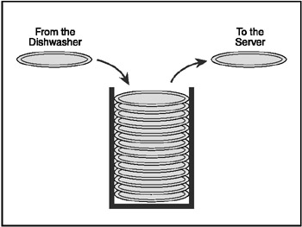
Stack concept
concept
Stack is an important data structure which stores its elements in an ordered manner
Analogy:
You must have seen a pile of plates where one plate is placed on top of another. When you want to remove a plate, you remove the topmost plate first. Hence, you can add and remove an element (i.e. the plate) only at/from one position which is the topmost position

Slide 5
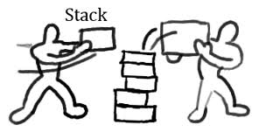
Stack concept
concept
Stack is a linear data structure which can be implemented by either using an array or a linked list.
The elements in a stack are added and removed only from one end, which is called the top.
The data are stored in Last In First Out (LIFO) way.

Slide 6

Stack concept
Array representation
Stack has two variables:
TOP which is used to store the address of the topmost element of the stack
MAX which is used to store the maximum number of elements that the stack can hold
If TOP = NULL, then indicates that the stack is empty
If TOP = MAX – 1, then the stack is full
TOP=4, insertion and deletion will be done at this position

Slide 7
Stack concept
Linked list representation
Technique of creating a stack using array is easier, but the drawback is that the array must be declared to have some fixed size.
In a linked stack, every node has two parts:
One that stores data
One that stores the address of the next node
The START pointer of the linked list is used as TOP
All insertions and deletions are done at the node pointed by the TOP
If TOP = NULL, then it indicates that the stack is empty

Slide 8
Stack concept
Stack Operations
push(x) : add an item x to the top of the stack.
pop() : remove an item from the top of the stack.
top() : reveal/return the top item from the stack.
Note: top is also known as peek.

Slide 9
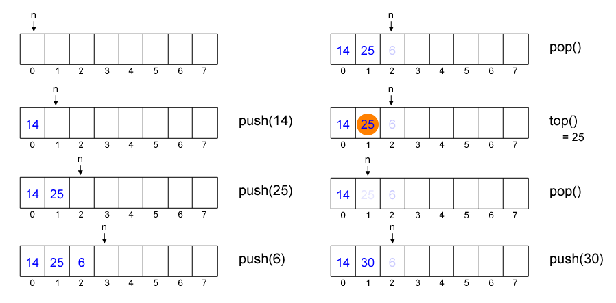
Stack concept
Example

Slide 10
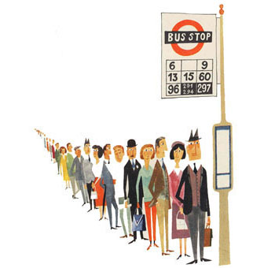
queue concept
concept
Queue is an important data structure which stores its elements in an ordered manner
Example:
People moving on an escalator. The people who got on the escalator first will be the first one to step out of it.
People waiting for a bus. The person standing in the line will be the first one to get into the bus
Luggage kept on conveyor belts
Cars lined for filling petrol
Cars lined at a toll bridge

Slide 11

queue concept
concept
Queue can be implemented by either using arrays or linked lists.
The elements in a queue are added at one end called the rear and removed from the other one end called front.
The data are stored in First In First Out (FIFO) way, this is the main difference between stack and queue.

Slide 12
queue concept
Array representation
Queue has two variables:
Front and rear that point to the position where deletions and insertions can be done respectively
For examples:
Here, front = 0 and rear = 5.
12 | 9 | 7 | 18 | 14 | 36
0 1 2 3 4 5 6 7 8 9

Slide 13
queue concept
Linked list representation
Similar with stack, technique of creating a queue using array is easy, but its drawback is that the array must be declared to have some fixed size.
In a linked queue, every element has two parts
One that stores the data
Another that stores the address of the next element
The START pointer of the linked list is used as the FRONT
All insertions will be done at the REAR, and all the deletions are done at the FRONT end.
If FRONT = REAR = NULL, then it indicates that the queue is empty

Slide 14
queue concept
Queue operations
push(x) : add an item x to the back of the queue.
pop() : remove an item from the front of the queue.
front() : reveal/return the most front item from the queue.
front is also known as peek.

Slide 15
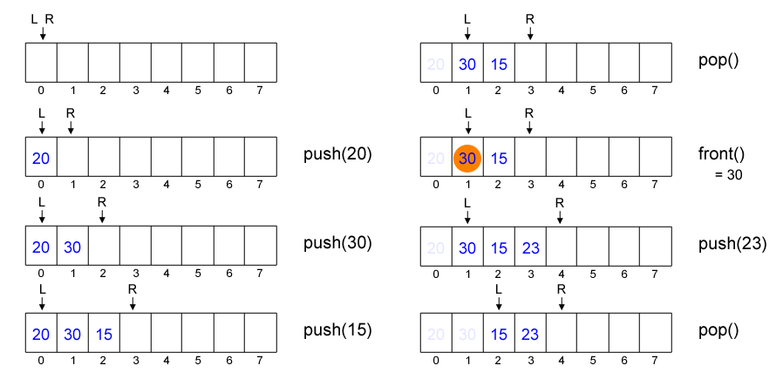
queue concept
Example

Slide 16
queue concept
Example
Using the previous implementation, let’s say we have an array with size of N.
What will happen if we push N times and pop N times, and we try to push another data into the queue?
Yes, we can not do that. The R index will overflow (exceeding N), which means the new data will be stored outside the array range.
It seems very inefficient, how to deal with this?

Slide 17
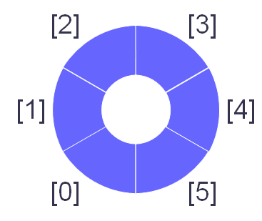
Circular queue
Concept
We can wrap-around index L and R.
If R reach MAXN then set R as zero, do the same to L.
It is also known as circular queue.

Slide 18
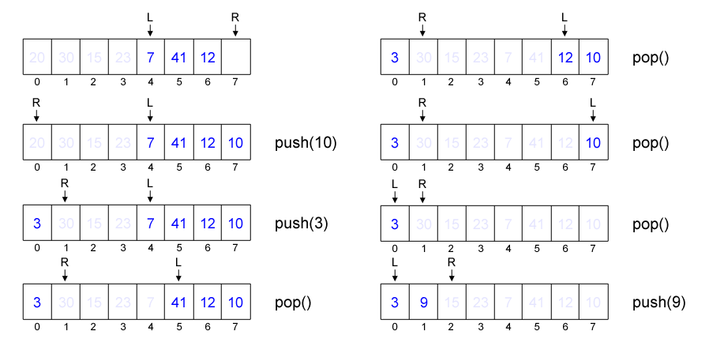
Circular queue
example

Slide 19
Stack & queue applications
Stack
Stacks are widely used to:
Reverse the order of data
Convert infix expression into postfix
Convert postfix expression into infix
Backtracking problem
System stack is used in every recursive function
Converting a decimal number into its binary equivalent

Slide 20
Stack & queue applications
Stack: Infix, prefix, postfix notation
Prefix | Infix | Postfix
* 4 10 | 4 * 10 | 4 10 *
+ 5 * 3 4 | 5 + 3 * 4 | 5 3 4 * +
+ 4 / * 6 – 5 2 3 | 4 + 6 * (5 – 2) / 3 | 4 6 5 2 – * 3 / +
Prefix : operator is written before operands
Infix : operator is written between operands
Postfix : operator is written after operands

Slide 21
Stack & queue applications
Stack: Infix, prefix, postfix notation
Prefix and postfix notations don’t need brackets to prioritize operator precedence.
Prefix and postfix is much easier for computer to evaluate.

Slide 22
Infix, prefix, postfix notation
Evaluation: Infix
Evaluate a given infix expression: 4 + 6 * (5 – 2) / 3.
To evaluate infix notation, we should search the highest precedence operator in the string.
4 + 6 * (5 – 2) / 3 search the highest precedence operator, it is ( )
4 + 6 * 3 / 3 search the highest precedence operator, it is *
4 + 18 / 3 search the highest precedence operator, it is /
4 + 6 search the highest precedence operator, it is +
10
In each search, we should iterate through the string and we do this for each existing operator.

Slide 23
Infix, prefix, postfix notation
Evaluation: postfix
Manually
Scan from left to right
7 6 5 x 3 2 ^ – + , scan until reach the first operator
7 6 5 x 3 2 ^ – + , calculate 6 x 5
7 30 3 2 ^ – + , scan again until reach next operator
7 30 3 2 ^ – + , calculate 3²
7 30 9 – + , scan again to search next operator
7 30 9 – + , calculate 30 – 9
7 21 + , scan again
7 21 + , calculate 7 + 24
28 , finish

Slide 24
Infix, prefix, postfix notation
Evaluation: postfix
Using Stack: Faster than manual
Algorithm:
Scan the string from left to right, for each character in the string:
If it is an operand, push it into stack.
If it is an operator, pop twice (store in variable A and B respectively) and push(B operator A).
Pay attention here! It is (B operator A), not (A operator B).
The result will be stored in the only element in stack.

Slide 25
Infix, prefix, postfix notation
Evaluation: postfix
Using Stack
String Stack Operations
4 6 5 2 – * 3 / +
4 6 5 2 – * 3 / + 4 push(4)
4 6 5 2 – * 3 / + 4 6 push(6)
4 6 5 2 – * 3 / + 4 6 5 push(5)
4 6 5 2 – * 3 / + 4 6 5 2 push(2)
4 6 5 2 – * 3 / + 4 6 3 pop 2, pop 5, push(5 – 2)
4 6 5 2 – * 3 / + 4 18 pop 3, pop 6, push(6 * 3)
4 6 5 2 – * 3 / + 4 18 3 push(3)
4 6 5 2 – * 3 / + 4 6 pop 3, pop 18, push(18 / 3)
4 6 5 2 – * 3 / + 10 pop 6, pop 4, push(10) → the result

Slide 26
Infix, prefix, postfix notation
Evaluation: prefix
Manually
Scan from right to left
+ 7 – x 6 5 ^ 3 2
+ 7 – x 6 5 ^ 3 2
+ 7 – x 6 5 9
+ 7 – x 6 5 9
+ 7 – 30 9
+ 7 – 30 9
+ 7 21
+ 7 21
28

Slide 27
Infix, prefix, postfix notation
Evaluation: prefix
Using Stack: Faster than manual
Algorithm:
Scan the string from right to left, for each character in the string:
If it is an operand, push it into stack.
If it is an operator, pop twice (store in variable A and B respectively) and push(A operator B).
Pay attention here! It is (A operator B), not (B operator A).
The result will be stored in the only element in stack.

Slide 28
Infix, prefix, postfix notation
Conversion: infix to postfix
Manually
Algorithm:
Search for the operator which has the highest precedence
Put that operator behind the operands
Repeat until finish

Slide 29
Infix, prefix, postfix notation
Conversion: infix to postfix
Manually
A + B – C x D ^ E / F , power has the highest precedence
A + B – C x D E ^ / F , put ^ behind D and E
A + B – C x D E ^ / F , x and / have same level precedence
A + B – C D E ^ x / F , put x at the end
A + B – C D E ^ x / F , continue with the same algorithm till finish
A + B – C D E ^ x F /
A + B – C D E ^ x F /
A B + – C D E ^ x F /
A B + – C D E ^ x F /
A B + C D E ^ x F / – , this is the Postfix notation

Slide 30
Infix, prefix, postfix notation
Conversion: infix to postfix
Using Stack
Given an infix expression, convert it into postfix notation.
Algorithm:
Scan the string from left to right, for each character in the string:
If it is an operand, add it to the postfix string.
If it is an open bracket, push it into stack.
If it is a close bracket, pop the stack until you found an open bracket. Add each popped element to the postfix string.
If it is an operator, pop while the stack’s top element has higher or equal precedence than the scanned character. Add each popped element to the postfix string. Push the scanned character into stack.
After you have scanned all character, pop all elements in stack and add
them to postfix string.

Slide 31
Infix, prefix, postfix notation
Conversion: infix to postfix
String | Stack | Postfix String | Operation
4 + 6 * (5 – 2) / 3 | - | - | -
4 + 6 * (5 – 2) / 3 |  | 4 | add(4)
4 + 6 * (5 – 2) / 3 | + | 4 | push(+)
4 + 6 * (5 – 2) / 3 | + | 4 6 | add(6)
4 + 6 * (5 – 2) / 3 | + * | 4 6 | push(*)
4 + 6 * (5 – 2) / 3 | + * ( | 4 6 | push(()
4 + 6 * (5 – 2) / 3 | + * ( | 4 6 5 | add(5)
4 + 6 * (5 – 2) / 3 | + * ( - | 4 6 5 | push(-)
4 + 6 * (5 – 2) / 3 | + * ( - | 4 6 5 2 | add(2)
4 + 6 * (5 – 2) / 3 | + * | 4 6 5 2 - | pop(-)
4 + 6 * (5 – 2) / 3 | + / | 4 6 5 2 - * | pop(*), push(/)
4 + 6 * (5 – 2) / 3 | + / | 4 6 5 2 - * 3 | add(3)
4 + 6 * (5 – 2) / 3 |  | 4 6 5 2 - * 3 / + | pop(/), pop(+)

Slide 32
Infix, prefix, postfix notation
Conversion: infix to postfix
Manually
Algorithm:
Search for the operator which has the highest precedence
Put that operator before the operands
Repeat until finish

Slide 33
Infix, prefix, postfix notation
Conversion: infix to postfix
Manually
A + B – C x D ^ E / F
A + B – C x ^ D E / F
A + B – C x ^ D E / F
A + B – x C ^ D E / F
A + B – x C ^ D E / F
A + B – / x C ^ D E F
A + B – / x C ^ D E F
+ A B – / x C ^ D E F
+ A B – / x C ^ D E F
– + A B / x C ^ D E F , this is the Prefix notation

Slide 34
Infix, prefix, postfix notation
Conversion: infix to postfix
Using Stack
It is quite similar with the conversion from infix to postfix, however the string is scanned from right to left.

Slide 35
Infix, prefix, postfix notation
Conversion: infix to postfix
String | Stack | Postfix String | Operation
4 + 6 * (5 – 2) / 3 | - | - | -
4 + 6 * (5 – 2) / 3 |  | 3 | add(3)
4 + 6 * (5 – 2) / 3 | / | 3 | push(/)
4 + 6 * (5 – 2) / 3 | / ) | 3 | push())
4 + 6 * (5 – 2) / 3 | / ) | 2 3 | add(2)
4 + 6 * (5 – 2) / 3 | / ) - | 2 3 | push(-)
4 + 6 * (5 – 2) / 3 | / ) - | 5 2 3 | add(5)
4 + 6 * (5 – 2) / 3 | / | - 5 2 3 | pop(-)
4 + 6 * (5 – 2) / 3 | / * | - 5 2 3 | push(*)
4 + 6 * (5 – 2) / 3 | / * | 6 - 5 2 3 | add(6)
4 + 6 * (5 – 2) / 3 | + | / * 6 - 5 2 3 | pop(*),pop(/),push(+)
4 + 6 * (5 – 2) / 3 | + | 4 / * 6 - 5 2 3 | add(4)
4 + 6 * (5 – 2) / 3 |  | + 4 / * 6 - 5 2 3 | pop(+)

Slide 36
Stack & queue applications
queue
There are several applications using queue data structure that we will discuss:
Deques
Priority Queues

Slide 37
Stack & queue applications
Queue: Deques
A deque (pronounced as ‘deck’ or ‘dequeue’) is a list in which elements can be inserted or deleted at either end.
It is also known as a head-tail linked list, because elements can be added to or removed from the front (head) or back (tail).

Slide 38
Stack & queue applications
Queue: Priority queue
A priority queue is an abstract data type in which each element is assigned a priority.
The general rule of processing elements of a priority queue can be given as:
An element with higher priority is processes before an element with lower priority
Two elements with same priority are processed on a first in first out (FIFO) basis

Slide 39
Stack & queue applications
Queue: Priority queue
Priority queue after insertion of a new node:
In above example, lower priority number means higher priority.
Pop: Pop is a very simple process in this case. The first node of the list will be deleted and the data of that node will be processed first

Slide 40
References
S. Sridhar. 2015. Design and Analysis of Algorithms. Oxford University Press. New Delhi. ISBN: 9780198093695. Chapter 5
Reema Thareja. 2014. Data structures using C. Oxford University Press. New Delhi. ISBN:9780198099307. Chapter 7 & 8
Thomas H. Cormen, Charles E. Leiserson, Ronald L. Rivest, & Clifford Stein. (2009). Introduction to Algorithms. 04. The MIT Press. London. ISBN: 9780262033848. Chapter 10.
Stack, https://visualgo.net/en/list?slide=4
Queue, https://visualgo.net/en/list?slide=5

